Slide 1

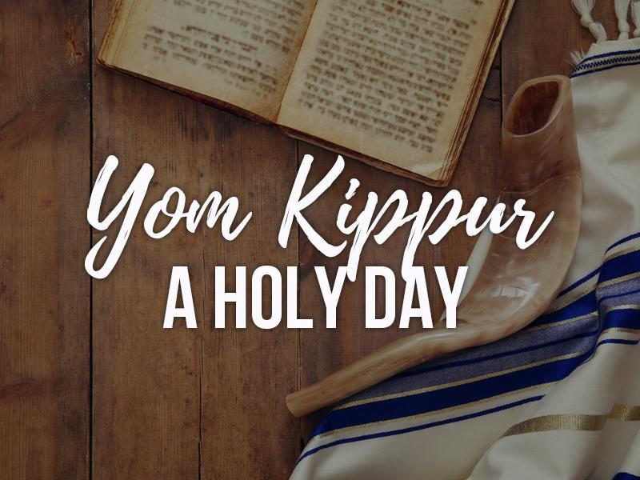
Human Relations, Diversity & Equity
Student Support and Attendance Services

Slide 2
Would you rather...
Just stay you
Become someone else

Slide 3
Objectives
Discuss the challenges of these beliefs
3
Learn about Yom Kippur
1
Identify the importance of the holiday in the Jewish faith
2

Slide 4
What Is Yom Kippur?
Also known as the Day of Atonement, it is considered the most important holiday in the Jewish faith.
Falls in the month of Tishrei (September or October).
Marks the end of the Ten Days of Awe (period of introspection & repentance that follows Rosh Hashanah, the Jewish New Year.
In the Jewish faith, Yom Kippur is believed to be the day that God will decide each person's fate for the upcoming year.

Slide 5
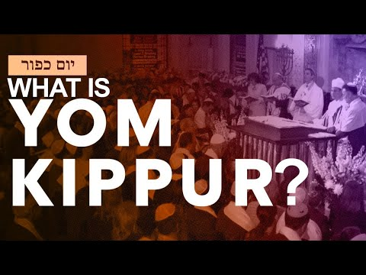
What Is Yom Kippur: The Jewish High Holy Day
Notes:
https://youtu.be/4oqBzg8wCUg (3:40)

Slide 6
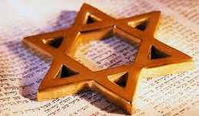
The Observance
In the Jewish faith, it is considered to be the most sacred day of the year
Lasts approximately 25 hours, from sundown to nightfall of the following evening
Observed by fasting along with abstaining from bathing and other restrictions.
Yom Kippur is a somber holy day of introspection and repentance.
Work is forbidden during the holiday

Slide 7
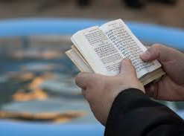
The Observance
High Holy Day prayer services include special liturgical texts, songs and customs, rabbis and their congregations read from a special prayer book known as the machzor during Yom Kippur.
Five distinct prayer services take place on Yom Kippur, the first on the eve of the holiday and the last before sunset on the following day.
One of the most important prayers specific to Yom Kippur describes the atonement ritual performed by high priests during ancient times.

Slide 8
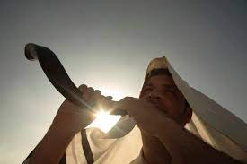
The Observance
The blowing of the shofar—a trumpet made from a ram’s horn—is an essential and emblematic part of both High Holy Days.
On Yom Kippur, a single long blast is sounded at the end of the final service to mark the conclusion of the fast.

Slide 9
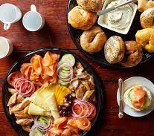

The Traditions & Symbols
Pre-Yom Kippur feast: On the eve of Yom Kippur, families and friends gather for a bountiful feast that must be finished before sunset. The idea is to gather strength for 25 hours of fasting.
Breaking of the fast: After the final Yom Kippur service, many people return home for a festive meal. It traditionally consists of breakfast-like comfort foods such as blintzes, noodle pudding and baked goods.

Slide 10
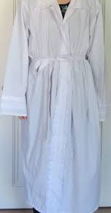
The Traditions & Symbols
Wearing white: It is customary for religious Jews to dress in white—a symbol of purity—on Yom Kippur. Some married men wear kittels, which are white burial shrouds, to signify repentance.
Charity: Some Jews make donations or volunteer their time in the days leading up to Yom Kippur. This is seen as a way to atone and seek God’s forgiveness. One ancient custom known as kapparot involves swinging a bundle of coins over one’s head while reciting a prayer. The money is then given to the poor.

Slide 11
Let's Chat: Check out
Teshuvah means that Jews make amends for past harms and commit to being better people in the world.
Do you ever reflect on your harms and search for ways to be better?
What is one way you could become an even better person?

Slide 12
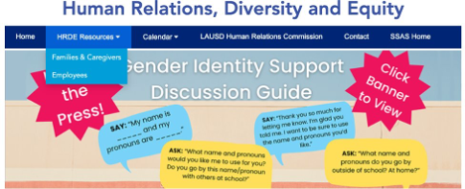
For additional resources, visit us at: https://www.lausd.org/human-relations

Slide 13
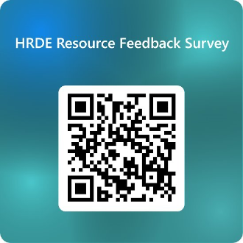
Teacher Feedback
Notes:
Teacher, please complete a brief feedback survey by scanning the QR code

